Slide 1
Fake News Detection Project
Idan Leibovitch
Evgenia Samsonov
Chanan Zevin

Slide 2
Mission statement
Probelm
With the fast news streaming between all social networks and to online news websites, where the competition is measuring who will get it faster and better. Naturally fake news was a by-product of that situation and by other factors (such as political interests etc).
Goal
Create an automatic tool that will classify every new item if it’s a True/False news

Slide 3
Overview
1
2
3
EDA
Data preparation
Data understanding
Cleaning, fixing, exploring and getting the initial insights
fit models, normalize, stemming and change text to numeric
4
5
6
Models testing
Select the winning model
Conclusions & insights
testing types of modeling and analyze the results

Slide 4
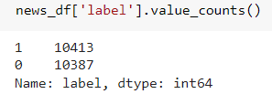
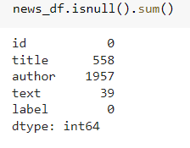
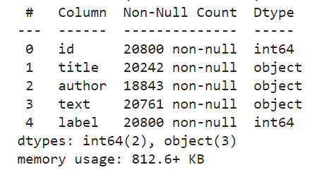
Data understanding
Data source
Balanced
The dataset is a mixed articles pulled from US based websites. (Kaggle)
Dataset is balanced :
Size
Shape of News data : (20800, 5)
Null values:
Columns
Columns type:
Columns: (['id', 'title', 'author', 'text', 'label']
'label’ : 1 - unreliable (fake)
0 - reliable (true)

Slide 5
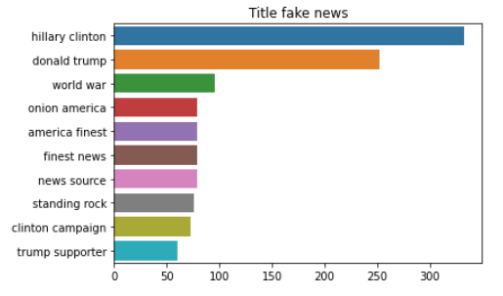
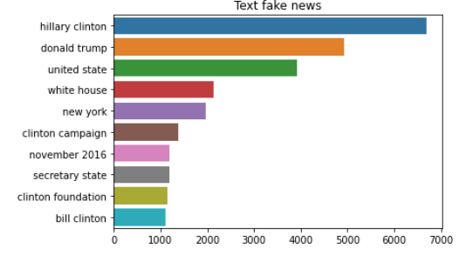
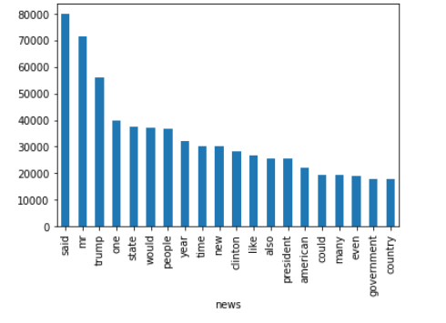
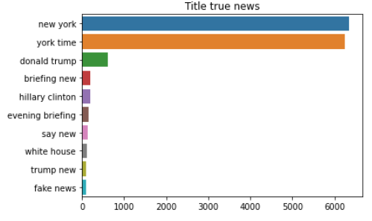
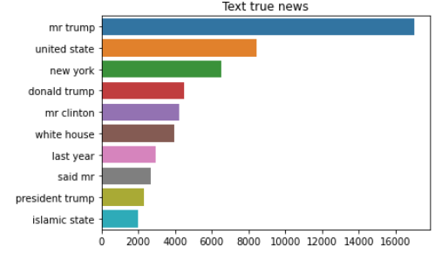
EDA
Most frequent words by labels
Top 20 words in the text:

Slide 6
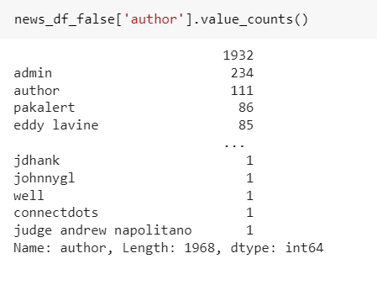
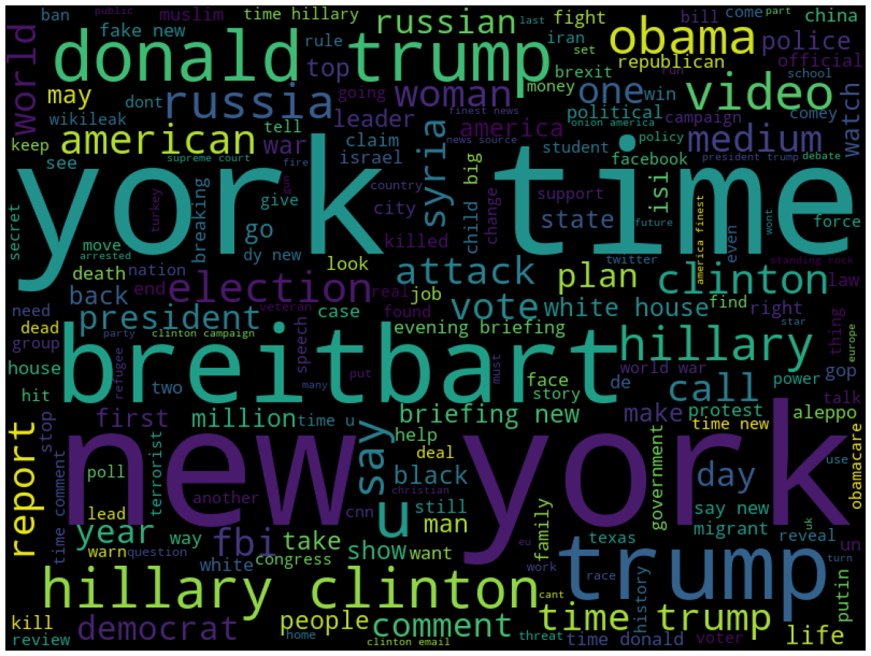
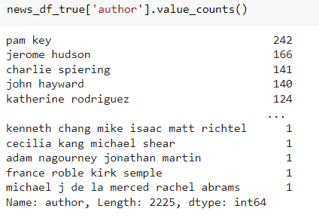
EDA
Authors by label comparison:
Another display for frequent words:

Slide 7
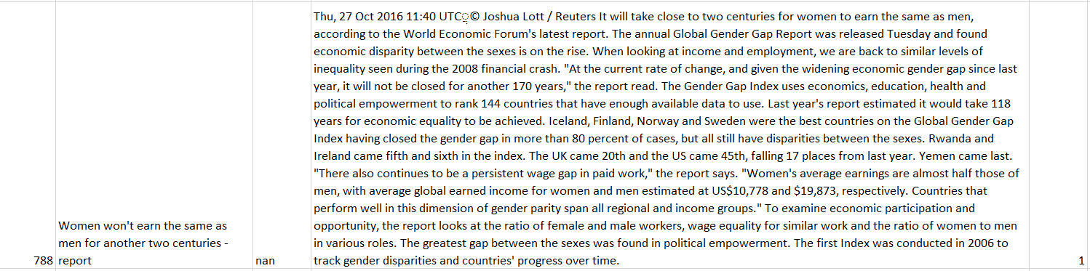
EDA
Text examples: can you guess if it is a fake or true?

Slide 8
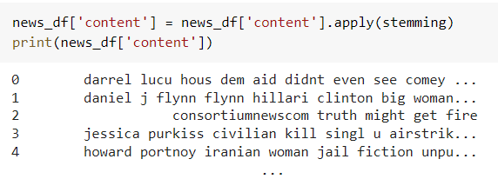
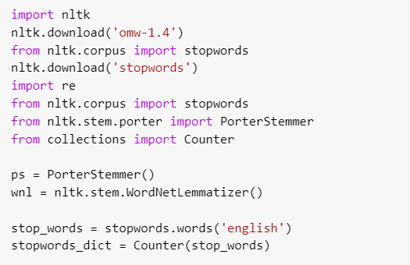

Data preparation
Stemming
Stop Words dealing
process of reducing a word to its Root word, example: actor ->actress, acting --> act
most commonly used in any language such as “the”,” a”,” an” etc.
Content Model
Merging author and title to one column

Slide 9
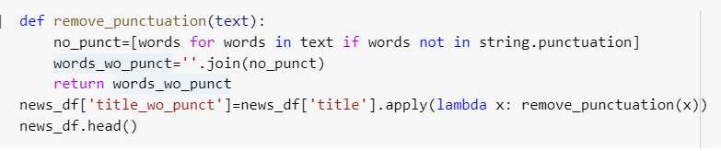
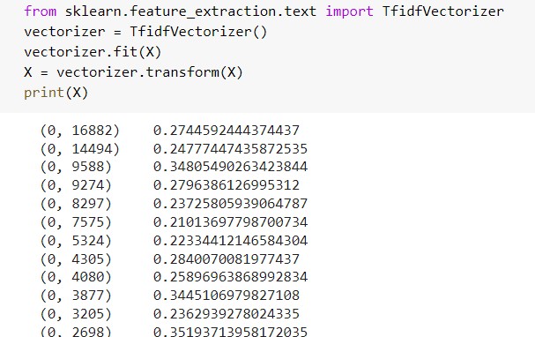
Data preparation
Punctuation dealing
TF-IDF
!"#$%&\'()*+,-./:;<=>?@[\\]^_`{|}~
numerical statistic which measures the importance of the word in a document

Slide 10
Models testing
Classification models
Logistic regression, Decision tree, KNN, Multinomial Naive Bayes , Passive-Aggressive classifier
Models tested
Sequence model
LSTM

Slide 11






Models testing
Comparing classification models results
Results for unprepared data
Results for prepared data

Slide 12



Models testing on full dataframe
Comparing classification models results
Results for unprepared data

Slide 13
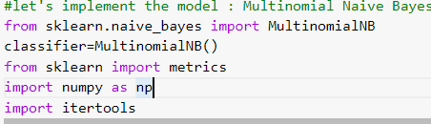
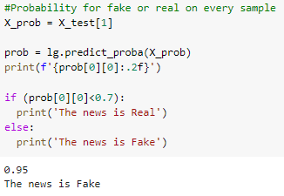
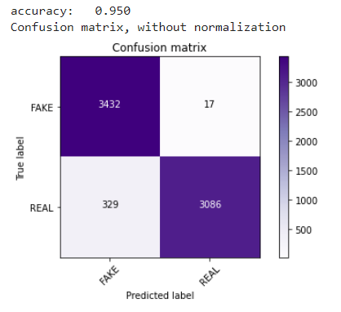
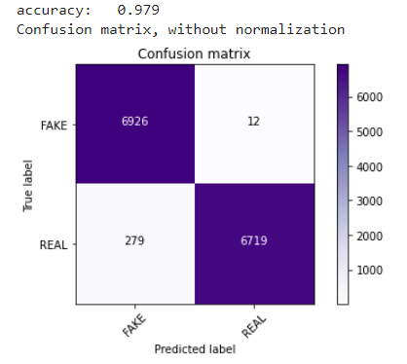

Models testing
Multinomial Naive Bayes
Multinomial Naive Bayes algorithm is a probabilistic learning method that is mostly used in Natural Language Processing (NLP)

Slide 14
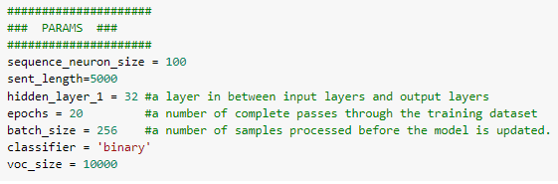
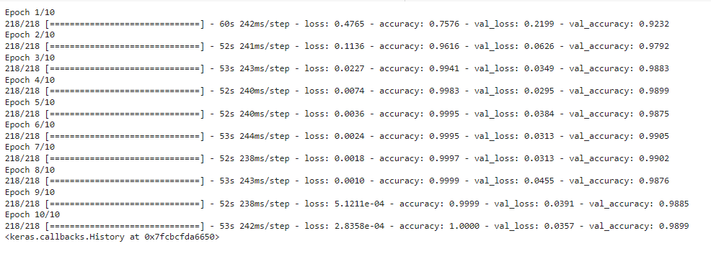
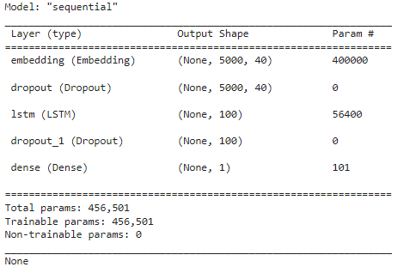
Models testing
LSTM Model
Sequential model with 1 LSTM layer of 100 neurons
Running 10 epochs

Slide 15
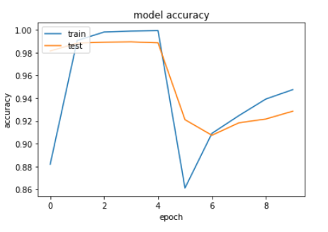
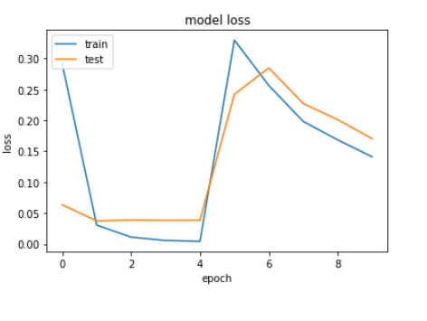
Models testing
LSTM Model
Optimal accuracy and loss were achieved with epoch 4
Check accuracy on test data:

Slide 16
Conclusions & Insights
1
2
3
4
Data cleaning
Validation
Winning model
Future plans
By the data given there is no necessary in stemming, removing punctuations etc since the results are good even without cleaning process. Looking for red flags such as the autor or extreme words could assist.
There are 2 types of validation in this project: our tool (work) and the source credibility. For validate our tool we need the lowest loss (log loss, RMSE) and for credibility we need to use likelihood.
There is no significant winning model, though Logistic regression was the one with high accuracy, lower log loss and yet less overfitted.
Pipeline for any data should include the “fast” version first and multiple models testing, considering the loss is to test our tool and accuracy for testing the source credibility

Slide 17
Thank you

